Slide 1

Team Details
Team Name: SafeGate
Team Leader: Sunil Kumar
Problem Statement: Open Innovation – Campus Safety & Emergency Response

Slide 2

Problem Statement
The Problem with Campus Emergencies
Panic
Manual Calls
Unclear Location
Delay
Risk
Emergency
Key Issues:
Slow response (8–15 mins)
Poor location accuracy
No priority handling
No coordination or tracking

Slide 3
Solution Overview :
Our Solution – SafeGate :
Emergency
One Tap
AI Analysis
Instant Alert
Navigation
Help < 2 min
Designed for:
College campuses
Hostels & libraries
Large academic zones
Night-time safety scenarios
One-line Pitch :
“SafeGate enables one-tap emergency reporting with AI-based priority and real-time responder navigation.”

Slide 4
Opportunities & Differentiation
Feature | Existing Systems | SafeGate
Response Time | 10–15 mins | < 2 mins
Location | Verbal / GPS | GPS + AI landmarks
Priority | Manual | AI Auto-triage
Responders | Security only | Volunteers + Security
Cost | High | Low (Google Cloud)
SafeGate’s Hidden Strengths :
Incident Memory: Past emergencies improve future response
Dynamic Resource Allocation: Closest + best-suited responder chosen
Multi-role Ecosystem: Students, volunteers, and staff work together
Offline Fail-Safe: Alerts retry automatically on poor networks

Slide 5
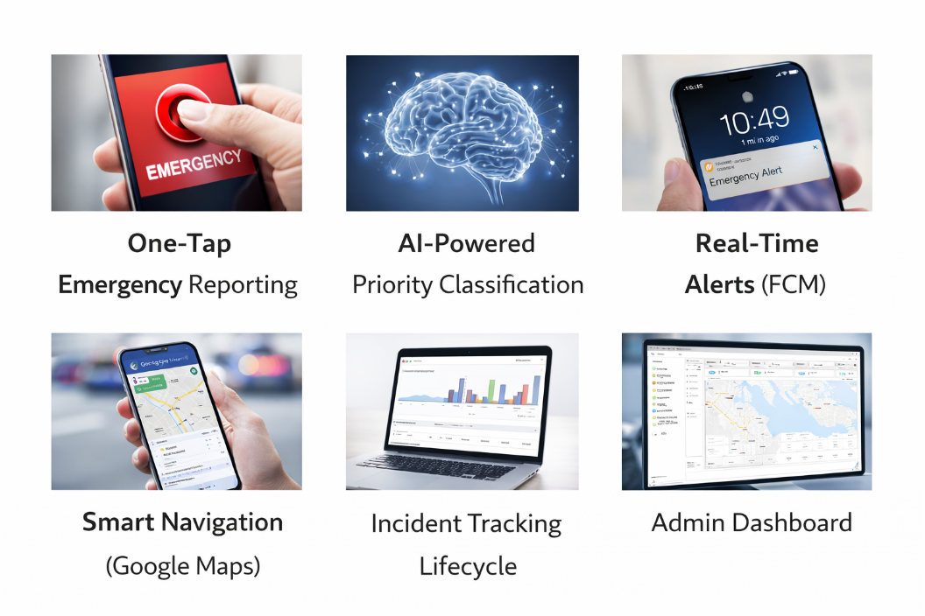
Features Offered :
Core Features :
🔴 One-Tap Emergency Reporting
🧠 AI-Powered Priority Classification
🚨 Real-Time Alerts (FCM)
🗺️ Smart Navigation (Google Maps)
📊 Incident Tracking Lifecycle
👨‍💼 Admin Dashboard

Slide 6
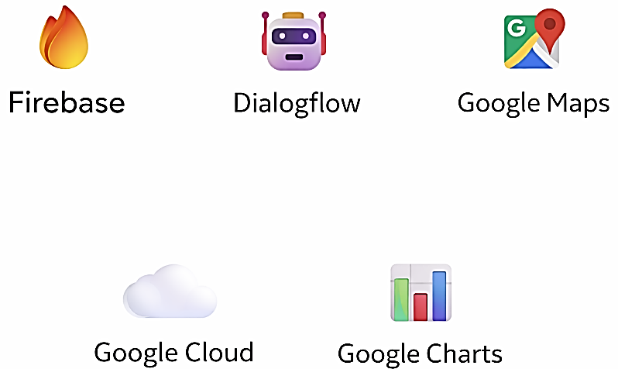
Google Technologies Used :
Google Tech Stack :
Firebase – Auth, Firestore, Notifications
Vertex AI – Emergency classification
Google Maps API – Navigation & ETA
Cloud Functions – Backend logic
Big Query – Analytics (future-ready)

Slide 7
Process Flow + Architecture :
How SafeGate Works :
Security & Privacy :
End-to-end encrypted alerts
Location shared only during emergencies
Role-based access (Student / Responder / Admin)
Secure cloud storage with access logs
Student taps emergency
Location auto-captured
AI classifies priority
Nearby responders alerted
Navigation starts
Incident resolved & logged
Architecture :
Student App
Firebase
Cloud Functions
Vertex AI
Maps
Responder App
Admin Dashboard

Slide 8
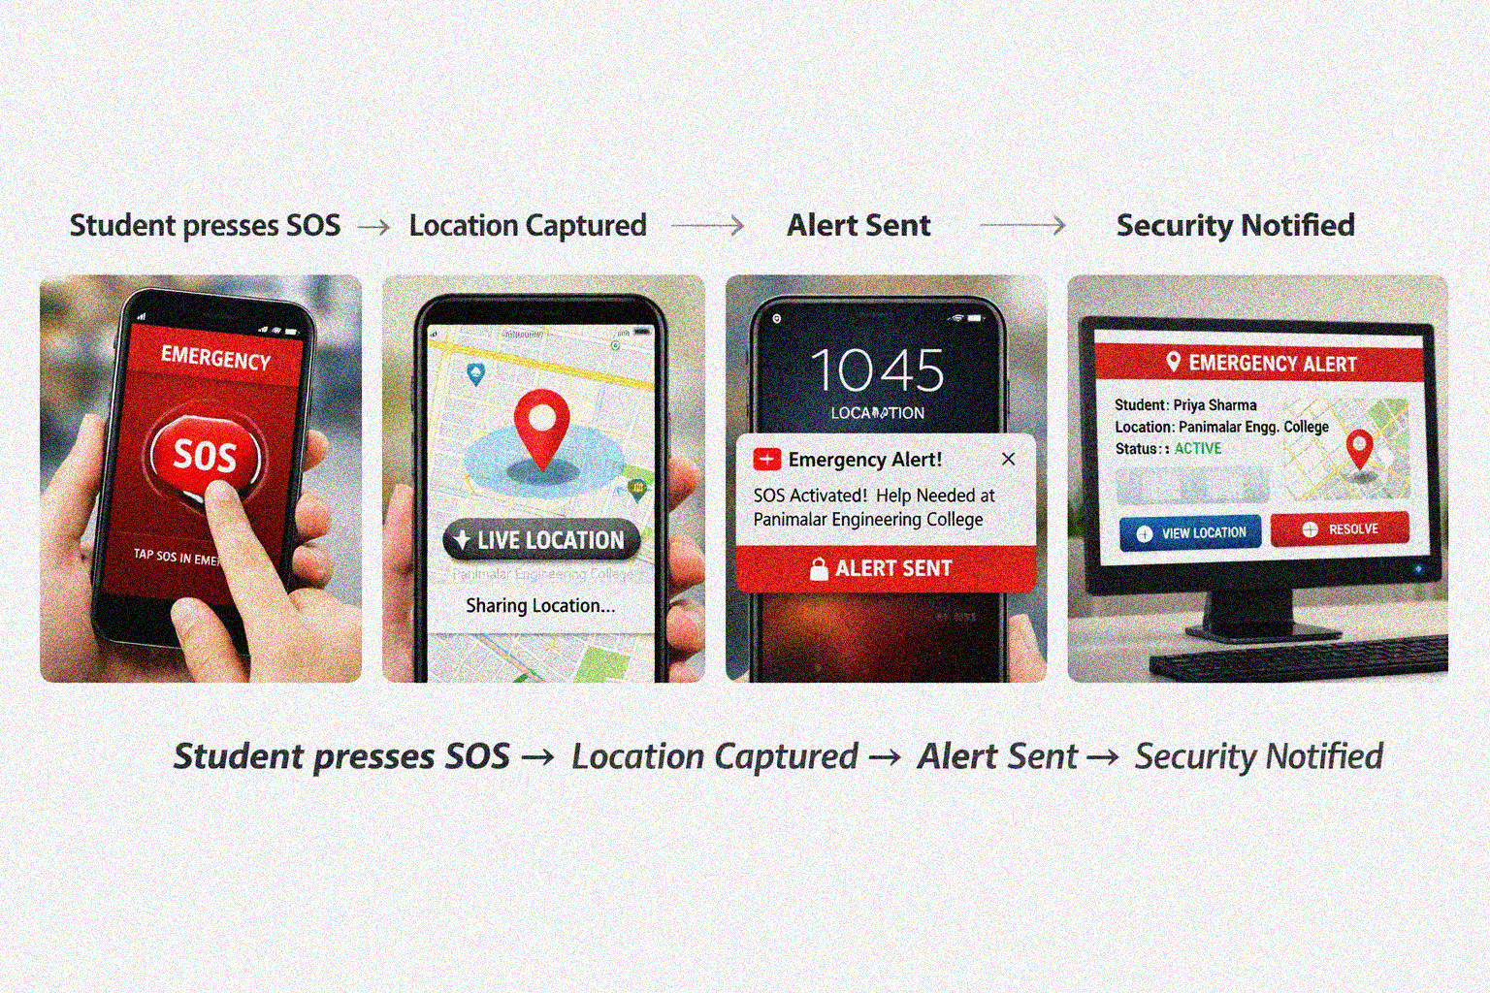
MVP (Prototype):
Prototype Name: SafeCampus – Emergency Alert System
What We Can Build Now: • SOS emergency button • Live location sharing • Security alert dashboard
Prototype Flow:

Slide 9
Provids links to Qour:
GitHub Public RspositorQ
Dsmo Vidso Link (3 Minutss)
MVP Link

Slide 10
Thank you!

